Slide 1

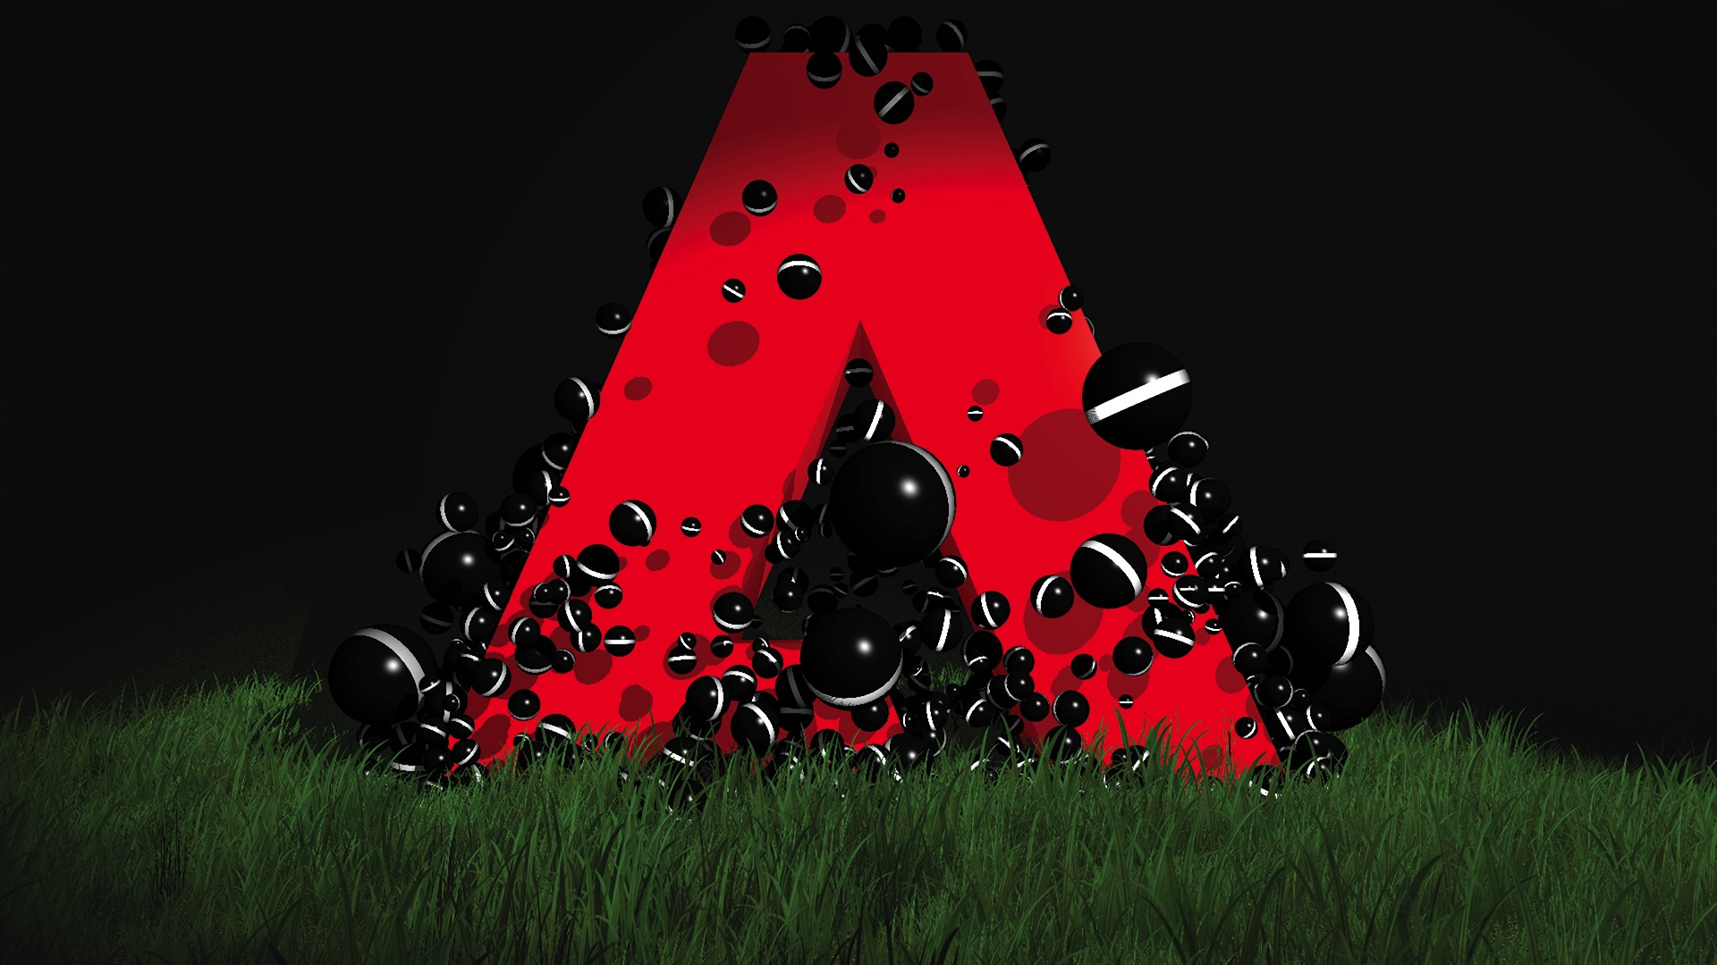
Service Initiative/Project Name – Overview & Highlights
Project Backlog
Requirement Backlog - Epics
Schedule and Key Milestones
Phases and Milestone dates
Akka HTTP — The What, Why and How
Using Scala
Author: Samir
Resourcing Plan
Resource Ramp up and down plan

Slide 2
Agenda
Introduction (Why we all need HTTP Stack ?)
What /Why is Akka and Actor
Actor Reactive principles
AKKA-HTTP Design Goals
AKKA-HTTP Implimentation
Akka-Http Vs Spray Vs Play
Akka-Http Server
Akka-Http Client
Routing DSL for Http Servers
Akka-Http Streaming

Slide 3
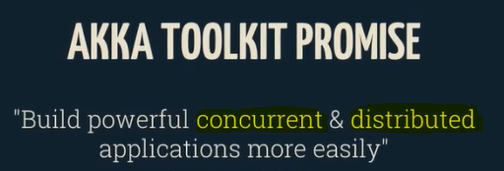
Introduction
Akka is a toolkit and runtime for building highly concurrent, distributed, and resilient message-driven
applications on the JVM.
The Akka HTTP modules implement a full server- and client-side HTTP stack on top of akka- actor and akka-stream. It’s not a web-framework but rather a more general toolkit for providing and
consuming HTTP-based services
Why Akka: Because microservices and streaming applications need more than clouds and
endpoints.
Why we all need HTTP Stack:
We live in a multi-everything world means , All our application are distributed to perform below operation
1) Multi-Thread
2) Multi-Cored
3) Multi-Machined
4) Multi-Data-Centerd

Slide 4
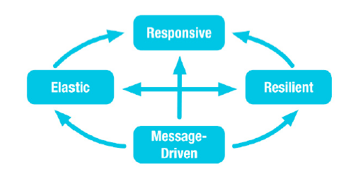
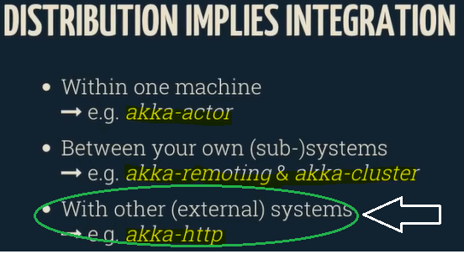

What is Akka and Actor
Writing correct distributed, concurrent, fault-tolerant and scalable applications is too hard. Most
of the time it’s because we are using the wrong tools and the wrong level of abstraction. Akka is here to change
that. Using the Actor Model we raise the abstraction level and provide a better platform to build scalable, resilient
and responsive applications. So Actors gives you
• Simple and high-level abstractions for distribution, concurrency and parallelism.
• Asynchronous, non-blocking and highly performant message-driven programming model.
• Very lightweight event-driven processes (several million actors per GB of heap memory).
Note: HTTP is the most successful external integration protocol do date !

Slide 5
Reactive principles guide line
The Reactive Manifesto (reactivemanifesto.org) defines reactive in terms of its four guiding principles:
1. Message-driven
2. Elastic
3. Resilient
4. Responsive
Message-driven means the application reacts to events by using a message-driven programming model. This allows the application to more effectively share resources by doing work only in response to outside messages.
Elastic means the application is able to react to increasing load by making the architecture highly oncurrent and distributed.
When an application is Resilient, it can easily deal with failure and recovery. Instead of the application simply dying, it manages failure through fault isolation so other parts of the application can keep running.
Responsive, means the application responds quickly not only in ideal conditions, but also when
there are application failures.

Slide 6
Continue...
Akka toolkit implements the following actor model
ActorSystem is the glue that wires Actors, ActorRefs, MessageDispatchers, and Mailboxes together. Programmers use the ActorSystem to configure the desired implementation of each of these components.
ActorRef is an addressable location. Messages destined for an underlying Actor are sent to an ActorRef.
MessageDispatcher is the engine that runs the other parts of the ActorSystem and schedules all its activities. The MessageDispatcher's main responsibility is to run Mailboxes. When an ActorRef receives a message, it dispatches it to the MessageDispatcher, which puts that message in the message queue for the destination Mailbox.
Mailbox is the component that holds Actors. Every Actor has its own mailbox. When the mailbox receives a slice of time to run, it takes a message from the message queue and invokes the Actor with the message.
MessageQueue is the first recipient of new messages. When the MessageDispatcher receives a message from the ActorRef, it delivers that message to the mailbox's Message Queue, where it sits until the mailbox receives CPU cycles to run.

Slide 7
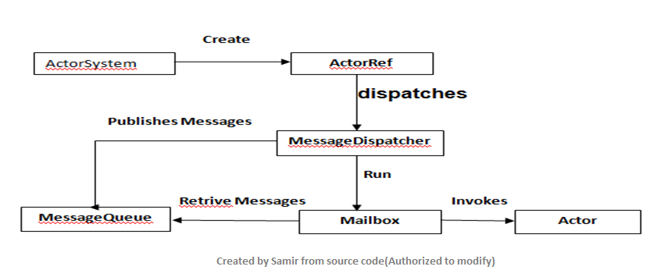
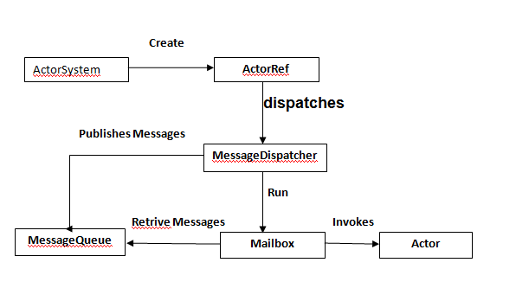
Continue...
Actor is an object that provides a receive method, which is invoked by the mailbox when it has a message to process.
To summarize: When you want to invoke the functionality of an actor in Akka, you send a message to the ActorRef. The ActorRef dispatches it to a MessageDispatcher, which delivers it to a Mailbox's MessageQueue. When the Mailbox receives a thread time slice from the MessageDispatcher, it retrieves the message from the MessageQueue and then invokes the Actor's receive method, passing it the message.
Actor model concurrency in Akka

Slide 8
Continu… Tell the Actor (To do something)
All communication with actors is done through asynchronous message passing. This is what makes actors reactive. An actor doesn’t do anything unless it’s been told to do something, and you tell it to do something by sending the message. Sending a message asynchronously means that the sender does not stick around waiting for the message to be processed by the recipient actor. Instead, the sender hands the message off by putting it on the recipient’s Mailbox and is then free to do something more important than waiting for the recipient to react on the message. The mailbox is not accessed directly in code, the sender of a message just sends a message to the ActorRef, and the actor simply has the message delivered to it, however it is useful to remember that the messages actually sit around in the mailbox until processed.
The actor’s mailbox is essentially a message queue and has ordering semantics. This guarantees that the ordering of multiple messages sent from the same sender is preserved, while the same messages can be interleaved with the messages sent by another sender. When the actor is not processing messages it does not consume any resources, apart from memory.
You tell an actor to do something by sending it a message with the tell method on the ActorRef. This method puts the message on the actor’s mailbox and then returns immediately.
Internally, the actor chooses its behavior depending on the type and properties of incoming messages. This behavior can be any standard logic such as modifying the internal state of an actor, creating or sending messages to other actors, business logic, or even changing the behavior of the actor itself.

Slide 9
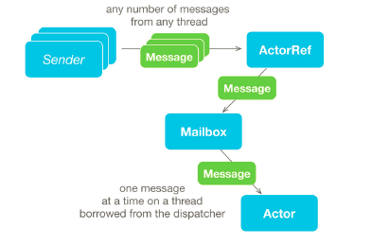
Continue…
To define the behaviors of an actor, you implement createReceive and return an instance of Receive, which is created using the method receiveBuilder(). After defining the types of messages that are handled, the builder is made to construct a Receive by calling build().

Slide 10
Load balancing and horizontal scalability
Akka's message-passing process might sound convoluted but it affords Akka two especially powerful benefits:
Load balancing: The MessageDispatcher can be configured with a one-to-one mapping of threads to actors, but it doesn't have to be. This means that the MessageDispatcher can maintain a thread pool that is configured to a sustainable quantity for the hardware on which it is running; but it can have far more actors than it does threads. Your application is still limited by the number of threads running actors, but unless all actors are always busy and using all of their CPU time-slices, this level of abstraction allows Akka to take advantage of actor downtime and support more load than a standard threading model could do.
Horizontal scalability: While vertical scalability refers to building out bigger and bigger machines that can individually do more work, horizontal scalability refers to running multiple machines together to complete the work. Akka can easily support horizontal scalability because your application never directly interacts with Actors, but instead interacts with ActorRefs. The two variations of an ActorRef are local and remote. Local ActorRefs deliver messages to a MessageDispatcher running in the same JVM. Remote ActorRefs send messages to a MessageDispatcher running on a different machine. This proxy/stub model is key to distributed computing; Akka exploits it to gain horizontal scalability without requiring your application to change beyond its Akka configuration.

Slide 11
Best Practices, Protocol for Actor
- Actors never interact directly with each other and instead communicate via messages. The behavior of an actor is primarily defined by how it handles messages as they are received. Since the state of an actor is isolated from the rest of the system, an actor never has to worry about synchronization issues, such as thread locking, when modifying its state.
Actors in Akka are extremely lightweight since they are standard objects that only consume a few hundred bytes each. The only constraint in number of actors is the amount of memory they consume. This means that a single application can easily create thousands or even millions of concurrent actors.
An important part of the Actor Model is that you never create actors directly, Instead, they are created by the ActorSystem. The returned value is not the actual actor; instead it is a reference to that actor called an ActorRef. There are three advantages to using this level of indirection and never accessing the actor directly:
1. The actor can be transparently restarted after failure.
2. The location of the actor is transparent, allowing Akka to manage when and where the actor runs.
3. The actor is able to maintain mutable state without worrying about concurrent access to this state.

Slide 12
Conti...
Actors should be like nice co-workers: do their job efficiently without bothering everyone else needlessly and avoid hogging resources. Translated to programming this means to process events and generate responses (or more requests) in an event-driven manner. Actors should not block (i.e. passively wait while occupying a Thread) on some external entity—which might be a lock, a network socket, etc.—unless it is unavoidable; in the latter case see below.
2. Do not pass mutable objects between actors. In order to ensure that, prefer immutable messages. If the encapsulation of actors is broken by exposing their mutable state to the outside, you are back in normal Java concurrency land with all the drawbacks.
3. Actors are made to be containers for behavior and state, embracing this means to not routinely send behavior within messages (which may be tempting using Scala closures). One of the risks is to accidentally share mutable state between actors, and this violation of the actor model unfortunately breaks all the properties which make programming in actors such a nice experience.
4. Top-level actors are the innermost part of your Error Kernel, so create them sparingly and prefer truly hierarchical systems. This has benefits with respect to fault-handling (both considering the granularity of configuration and the performance) and it also reduces the strain on the guardian actor, which is a single point of contention if over-used.

Slide 13
Conti..
Shared mutable state is a cause of many concurrency problems. Akka actors solve this problem by processing a single message at a time and transparently handling memory visibility when the actor executes on different threads over time. Many threads can hold an ActorRef and send messages to it concurrently, yet the actor will process them in a linear fashion. Accessing or mutating the internal state of an actor is fully thread safe since the thread is protected by the Actor Model.
The strong isolation principles of actors, together with the messagedriven model and location transparency, make it easy to solve hard concurrency and scalability problems in an intuitive way. It abstracts away the underlying threading model and actor scheduling so you can focus on building your application and not infrastructure.
An actor is created by defining a class that extends AbstractActor and implements the createReceive method to define how the actor should react to the different messages it receives.
Note: Since we need Akka to manage the actor’s lifecycle, we don’t create it directly just using the “new”
operator, but instead ask the ActorSystem to create and manage the actor for us.

Slide 14
Conti…
This level of indirection adds a lot of power and flexibility. It enables location transparency, which means that the ActorRef can, while retaining the same semantics, represent an instance of the running actor in-process or on a remote machine (i.e. location doesn’t matter). This also means that the runtime can optimize the system by changing an actor’s location or the application’s topology while it is running. This level of indirection also enables the “let it crash” model of failure management, in which the system can heal itself by crashing and restarting faulty actors.
To create (top level) actors in Akka you use the ActorSystem. actorOf factory method. This method takes a configuration object called Props and an optional name.
Actor hierarchy Creating an actor using the ActorSystem directly creates the actor at the top of the hierarchy. Actors can also be created as children of other actors using an actor’s local ActorContext.The ActorContext contains information about the ActorSystem relevant to each actor, such as who its parent and children are. When an actor uses this context to create another actor, the new actor becomes a child actor. In this way, the actor hierarchy gets built out.

Slide 15
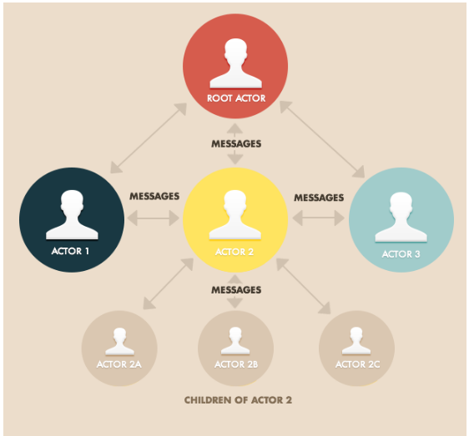
Cont.. (Diagram of actor hierarchy )

Slide 16
Defining Actor Messages
- An actor does not have a public API in terms of methods that you can invoke. Instead, its public API is defined through a protocol, the set of messages, that the actor handles. Messages can be ofarbitrary type (any subtype of Object). This means that we can send boxed primitive values (such as String, Integer, Boolean,etc.) as messages or plain data structures like arrays, collection types, and value objects. However, since the messages are theactor’s public API, you should define messages with good names and rich semantic and domain-specific meaning, even if it’s just wrapping your data type. This makes it easier to use, understand, and debug actor-based systems.

Slide 17
Akka-Remoting (How to Form Associations between Remote Systems)
So imagine we have the following two actor systems configured to both use the helios.tcp Akka.Remote transport:
Client
akka {
actor {
provider = "Akka.Remote.RemoteActorRefProvider, Akka.Remote"
}
remote {
helios.tcp {
port = 0 # bound to a dynamic port assigned by the OS hostname = localhost
}
}
}
Server
akka {
actor {
provider = "Akka.Remote.RemoteActorRefProvider, Akka.Remote"
}
remote {
helios.tcp {
port = 8081 #bound to a specific port hostname = localhost
}
}
}

Slide 18
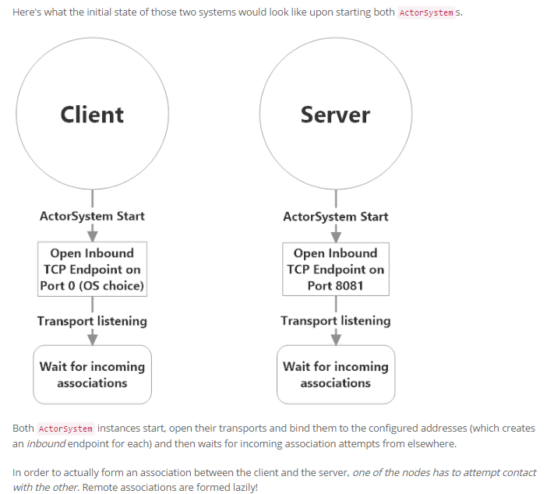
Conti...

Slide 19
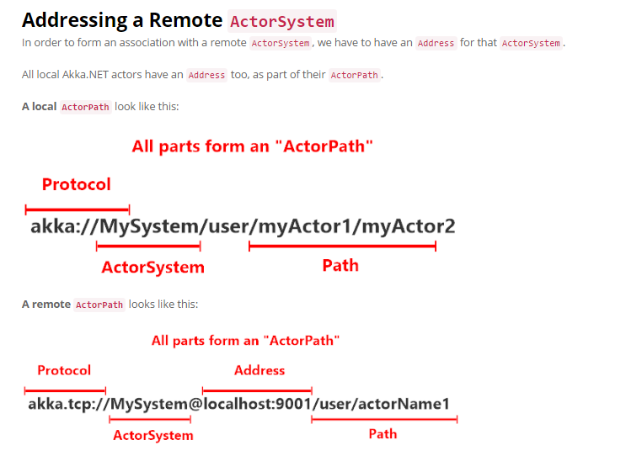
Conti..

Slide 20
Conti...
Each ActorPath consists of four parts:
1. Protocol - this defines the protocol used to communicate with this actor. Default local protocol is in-memory message passing.
2. ActorSystem - the name of the ActorSystem to which this actor belongs.
3. Address - refers to the inbound endpoint you can use to communicate with this actor via the protocol. There's a default address for local-only actors and it always get committed from local ActorPaths.
4. Path - refers to the path of this actor in the hierarchy.
When you want to connect to a remote ActorSystem, two important changes occur to the address:
The protocol gets augmented with the protocol of the network transport - so in this case, since we're using the Helios TCP transport the protocol for communicating with all remote actors in our ActorSystemchanges from akka:// to akka.tcp://. When you deploy an actor remotely or send a message to a remote actor via ActorSelection, specifying this protocol is what tells your local ActorSystem how to deliver this message to the remote one!
2. The address gets populated with the inbound endpoint on the transport localhost:9001 in this case. This lets your local system know how to attempt to establish an outbound endpoint to the remote ActorSystem.
Here's how we actually use a remote Address to form an association between two remote ActorSystem instances.

Slide 21
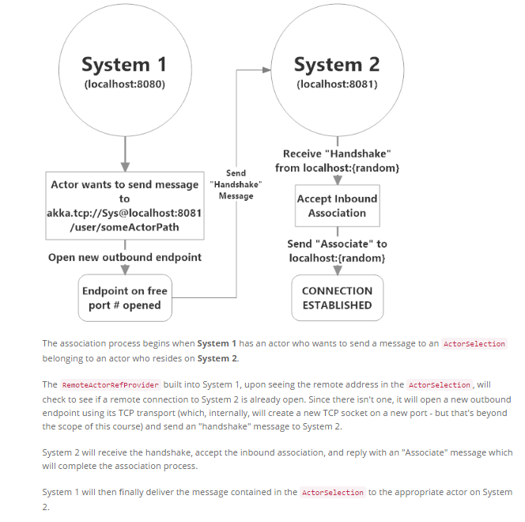
The Association Process

Slide 22
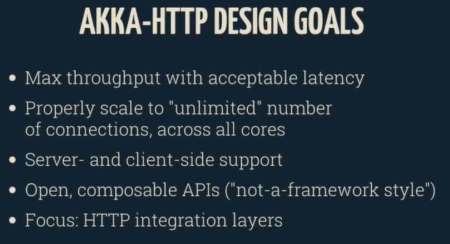

Slide 23
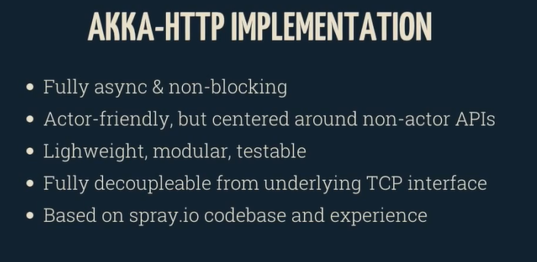
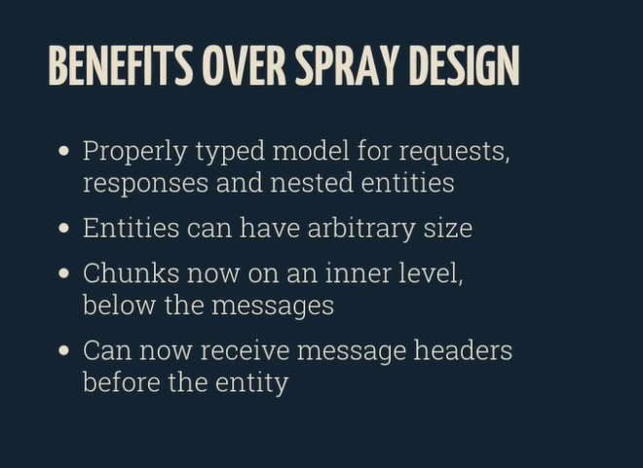

Slide 24
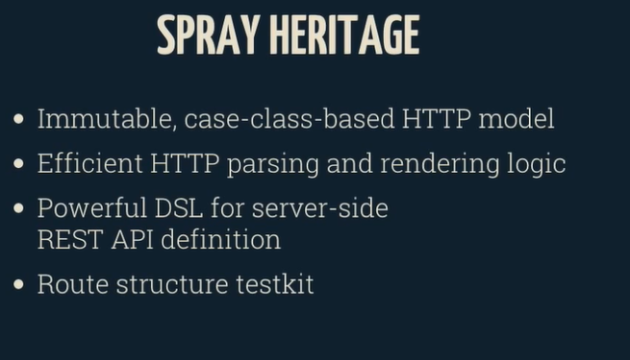
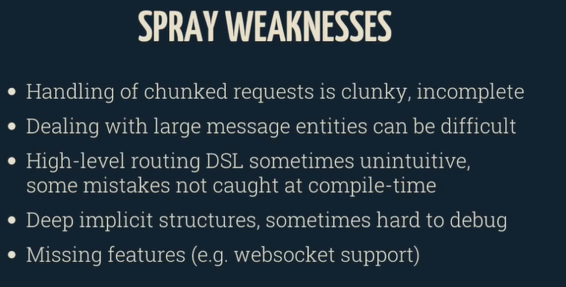

Slide 25
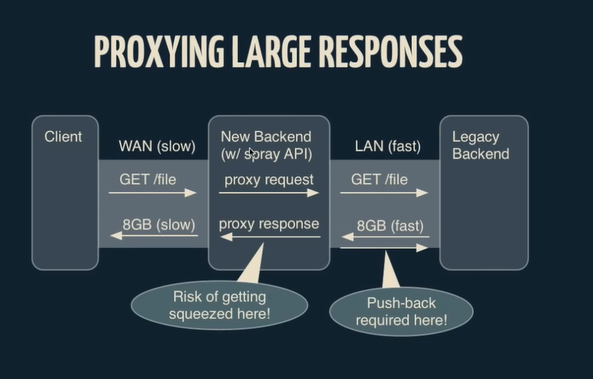

Slide 26
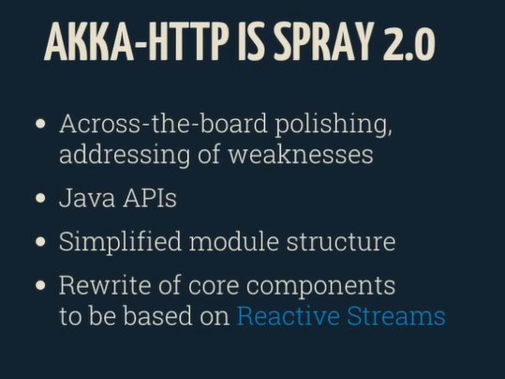

Slide 27
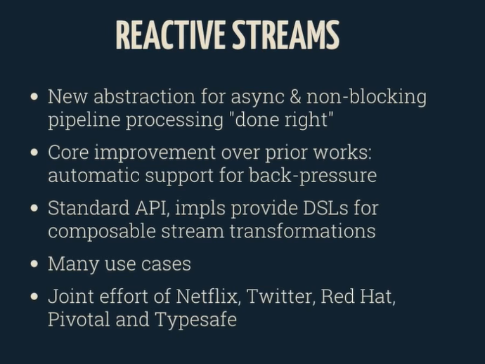

Slide 28
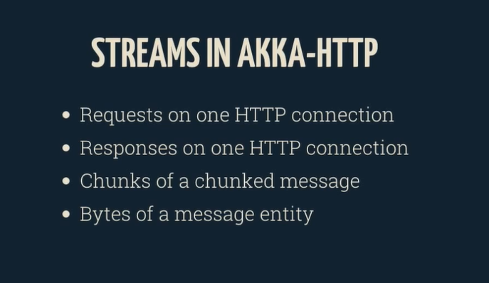
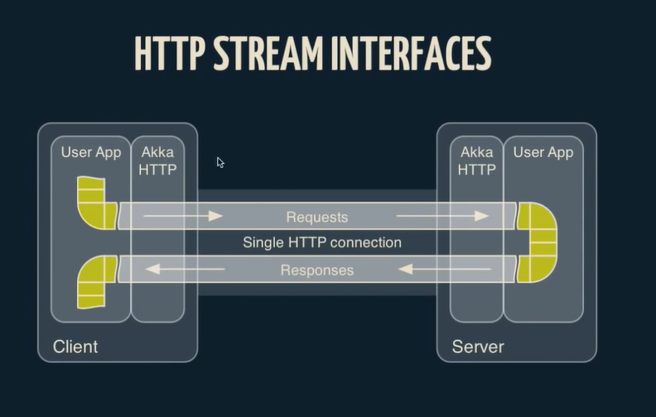

Slide 29
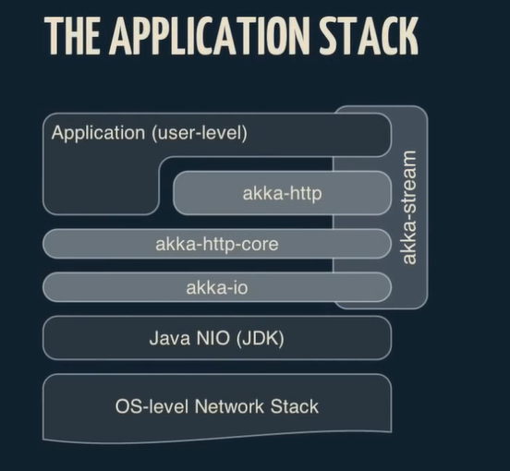
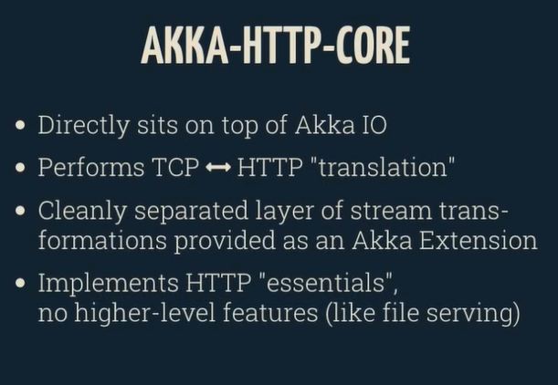
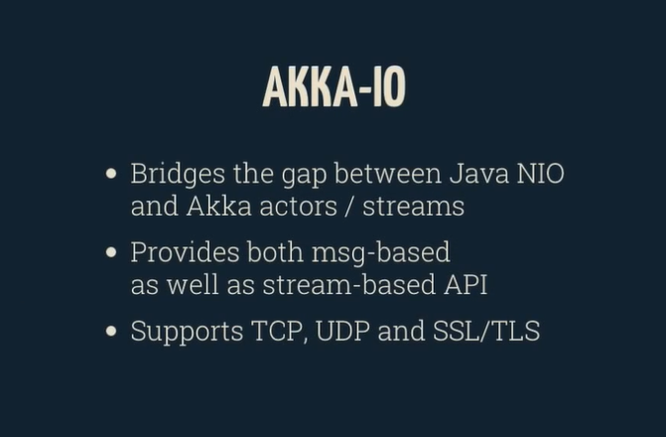
Physical Architecture

Slide 30
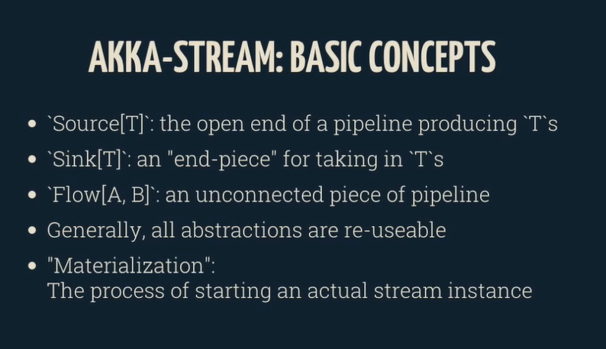

Slide 31
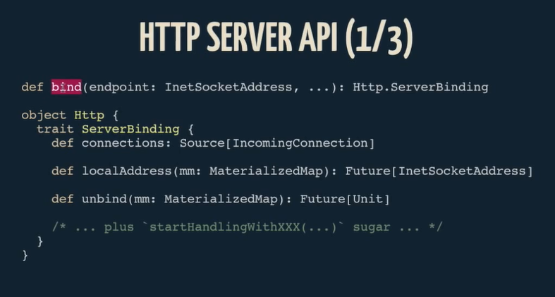
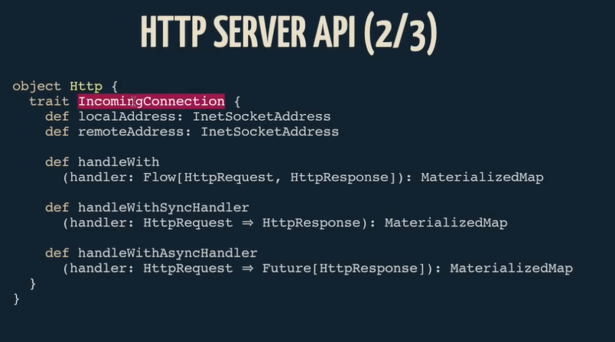
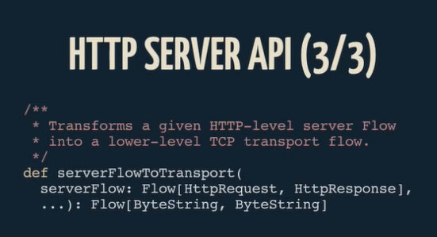
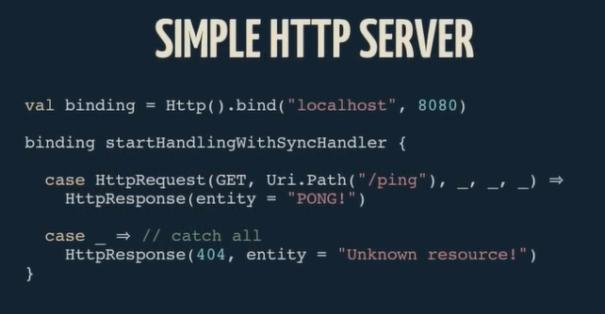

Slide 32
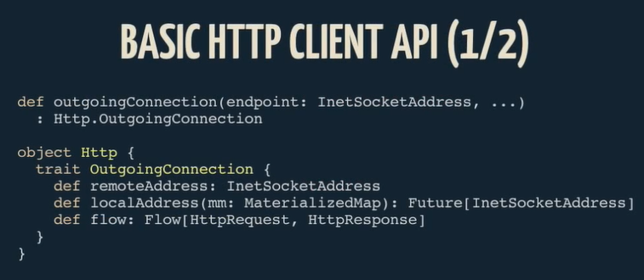
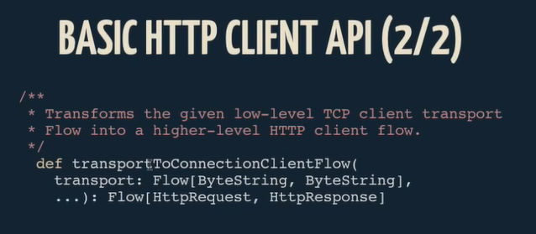
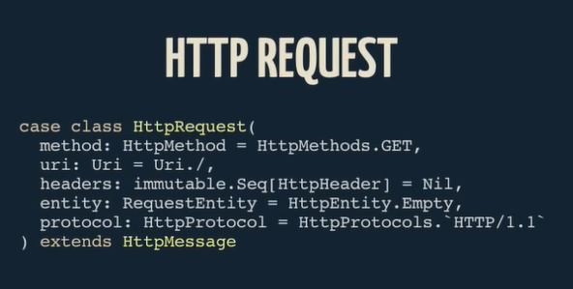
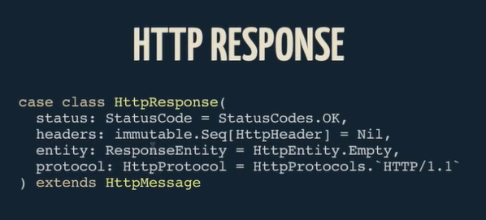

Slide 33
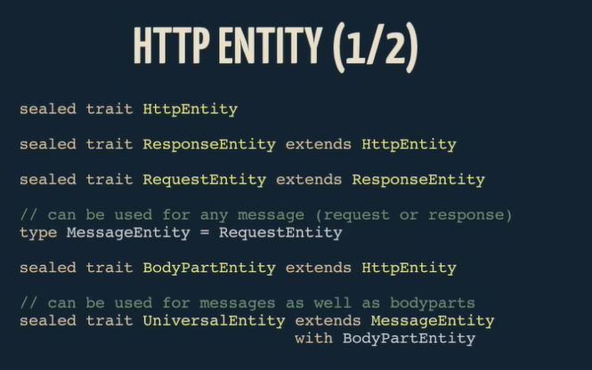
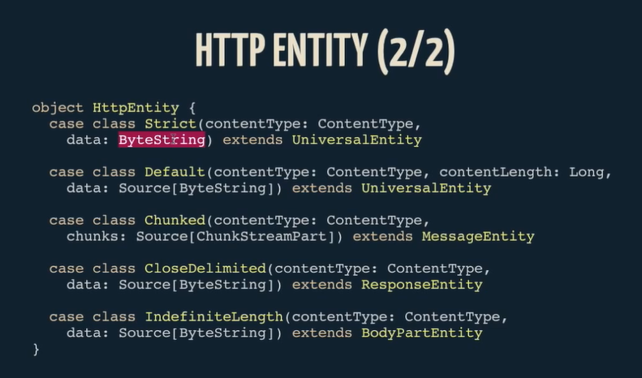

Slide 34
DEMO

Slide 35
